Slide 1

Automatic Water Level Controller with Mobile App
IoT-Based Smart Water Management System | Real-time Monitoring | Automatic Control

Slide 2

The Water Management Challenge
Traditional manual water tank monitoring creates significant inefficiencies and costs for property owners across residential and commercial settings.
Inconvenient Monitoring
30% Water Wastage
Manual tank checks are time-consuming and unreliable, requiring constant vigilance
Pump overrun leads to tank overflow, wasting precious water resources
High Energy Costs
Equipment Damage
Unnecessary pump operation drives up electricity bills significantly
Dry running destroys pump motors, resulting in expensive repairs and replacements

Slide 3

A Growing Market Opportunity
The smart water management sector is experiencing explosive growth, driven by rising utility costs and sustainability concerns. With 70% of households still relying on outdated manual systems, there's enormous potential for disruption.
Target Markets
Residential homes and apartments
Hotels and hospitality venues
Hospitals and healthcare facilities
$21.4B
Industrial and commercial properties
Market Size by 2028
Projected global smart water management value
70%
Manual Systems
Households still using traditional monitoring

Slide 4
Intelligent Automation Meets User Control
Our solution combines fully automatic operation with flexible manual control, giving users complete peace of mind whilst maintaining full authority over their water systems.
1
2
3
Automatic Pump Control
Real-time Dashboard
Manual Override
Intelligent water level detection triggers pump operation precisely when needed
Monitor water levels remotely from anywhere via intuitive mobile interface
Take control instantly with one-touch manual operation when desired
4
5
Instant Alerts
Dry-run Protection
Receive notifications for critical conditions requiring immediate attention
Advanced safety systems prevent pump damage from running without water

Slide 5
Built on Proven Technology
Our system leverages industry-standard components and modern web technologies to deliver reliability, performance, and seamless user experience.
Sensors
Controller
Communication
Ultrasonic HC-SR04 distance sensors with float switch backup for accurate level detection
ESP32/Arduino microcontrollers providing robust processing and WiFi connectivity
WiFi connectivity with MQTT protocol for reliable, low-latency data transmission
Frontend Stack
Mobile App
React with TypeScript and Tailwind CSS for responsive, type-safe development
Progressive Web App technology enables cross-platform access without app store downloads

Slide 6





How the System Works
Continuous Sensing
Sensors measure water levels in real-time with high precision
Intelligent Processing
Controller analyses data and manages pump operations automatically
Cloud Transmission
Data streams securely to cloud infrastructure via WiFi connection
Mobile Dashboard
App displays status and enables remote control capabilities
Flexible Control
Seamless switching between automatic and manual operation modes

Slide 7
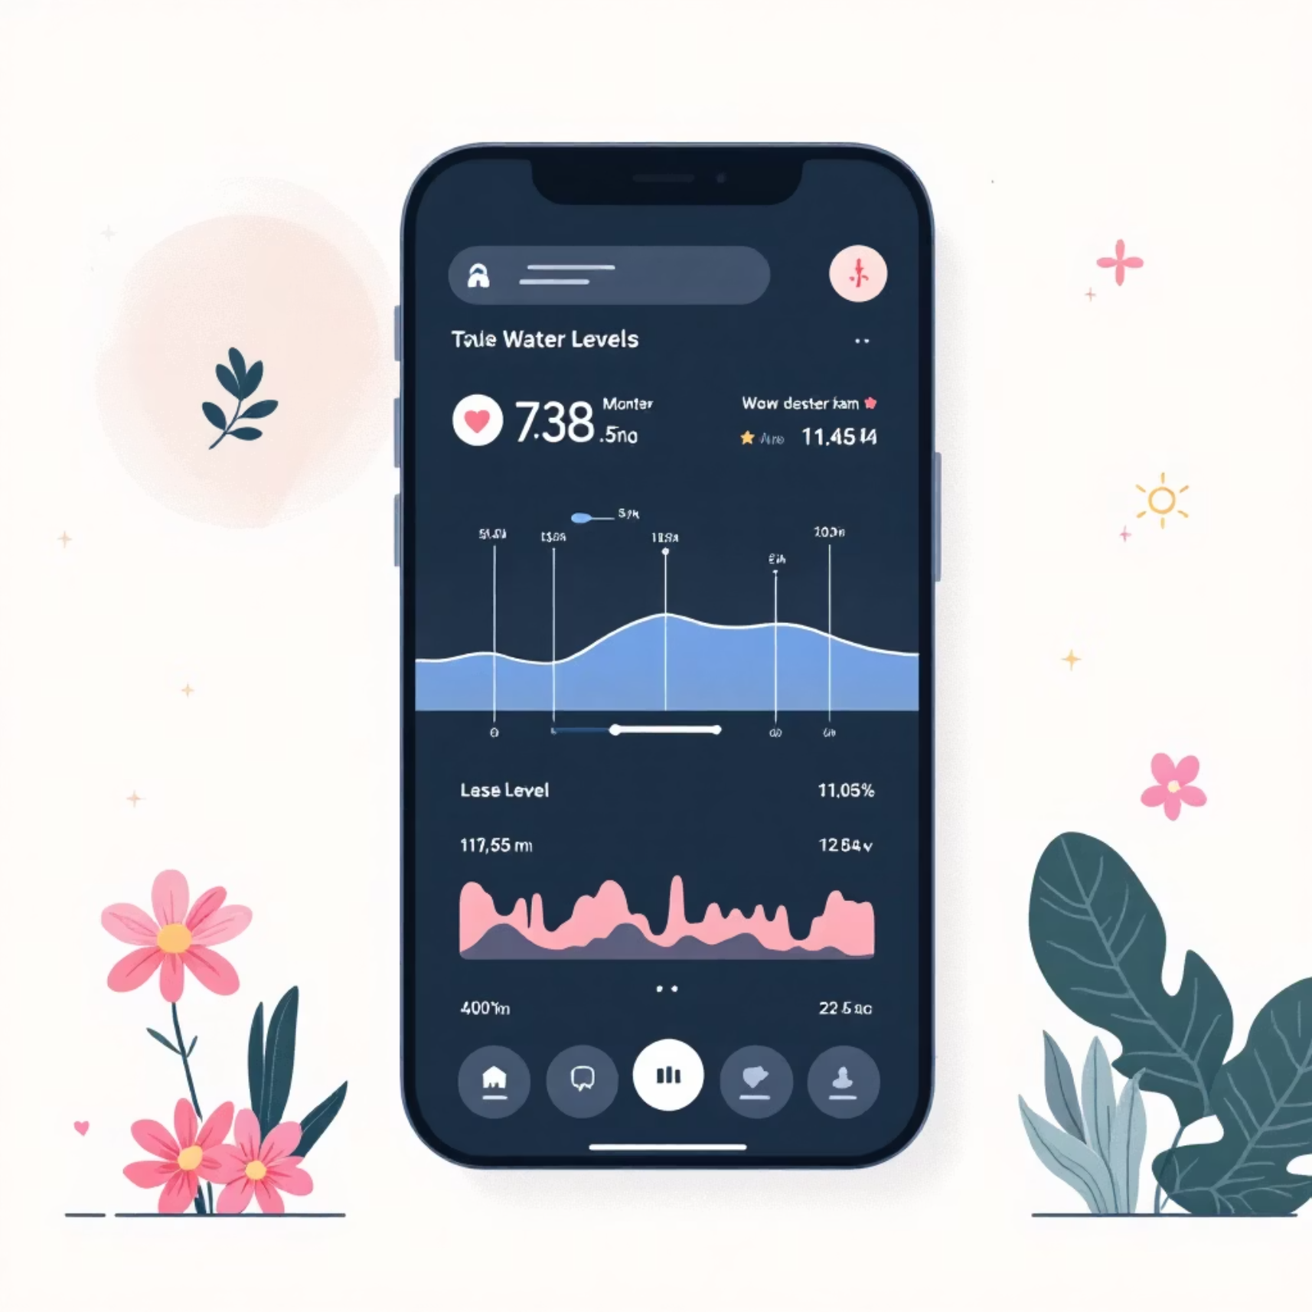
Comprehensive Feature Set
Real-time Water Percentage
Live water level display with visual indicators and percentage readouts
Automatic Pump Control
Pump activates at low levels, deactivates when tank reaches capacity
Manual Override Mode
One-touch control for immediate pump operation when needed
Connection Status
Clear indicators showing system connectivity and operational health
Alert Management
Notification history and instant alerts for critical conditions
Dark-themed Interface
Modern, eye-friendly dashboard optimised for all lighting conditions

Slide 8
Measurable Benefits for Users
Our smart water controller delivers tangible returns through resource conservation, cost reduction, and equipment protection whilst enhancing convenience.
Water Conservation
Energy Savings
Pump Protection
Ultimate Convenience
Reduce wastage by up to 30% through precise automatic control and overflow prevention
Lower electricity bills by 20-25% with optimised pump operation cycles
Extend equipment lifespan significantly with dry-run prevention and smart operation
Monitor and control your water system from anywhere in the world

Slide 9
Why Choose Our Solution
Affordable Implementation
User-friendly Interface
No Ongoing Fees
Intuitive dashboard design ensures anyone can monitor and control their water system effortlessly, regardless of technical expertise
Zero monthly subscription charges mean your investment pays for itself quickly through savings on water and electricity bills
Complete system costs just £30-50 in components, making smart water management accessible to everyone without breaking the budget
Scalable Architecture
Open Standards
Easily customisable and expandable to accommodate growing needs, from single homes to multi-property installations
Built on industry-standard protocols ensuring compatibility, reliability, and future-proof operation without vendor lock-in

Slide 10
Future Development Roadmap
We're committed to continuous innovation, with exciting enhancements planned to deliver even greater value and functionality to our users.
Water Analytics
1
Detailed consumption tracking and usage pattern analysis with insights
2
Predictive Maintenance
AI-powered alerts anticipating equipment issues before they occur
Voice Control
3
Integration with Alexa, Google Assistant, and other voice platforms
4
Multi-tank Support
Manage multiple water tanks from a unified dashboard interface
Quality Monitoring
5
Additional sensors for pH, TDS, and water quality parameters

